Slide 1
Open science training
Iryna Kuchma, EIFL Open Access Programme
“Building a cohort of open scholarship trainers to boost adoption of DataCite open infrastructure services among the Consortium of Uganda University Libraries” Busitema University Library, May 27, 2024
Attribution 4.0 International

Slide 2

UNESCO Recommendation on Open Science
It is the first international instrument on Open Science;
normative
it contains the first internationally agreed definition of Open Science;
it spells out the consensus core values and guiding principles of Open Science;
it addresses multiple actors and stakeholders
of Open Science;
It recommends actions on different levels to operationalize the principles of Open Science;
it proposes innovative approaches for Open Science at different stages of the scientific cycle;
it calls for development of a comprehensive Open Science monitoring framework.

Slide 3

Open science is a practice to make scientific knowledge openly available, accessible and reusable for everyone, to increase scientific collaborations and sharing of information for the benefits of science and society, and to open the processes of scientific knowledge creation, evaluation and communication to societal actors beyond the traditional scientific community
UNESCO Recommendation on Open Science, 2021

Slide 4
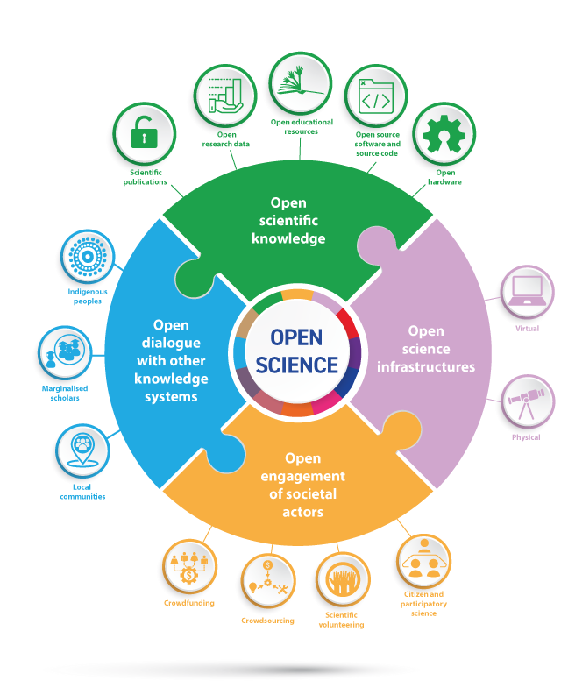
UNESCO Recommendation on Open Science, 2021

Slide 5
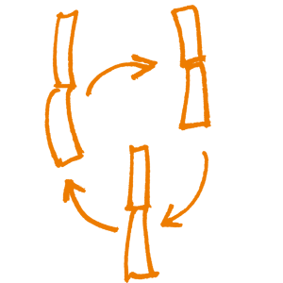
Open science practices
Open Access to publications, data, software and other research outputs
Research data management according to CARE (Collective Benefit, Authority to Control, Responsibility and Ethics) and FAIR (Findable, Accessible, Interoperable and Reusable) principles
Open Educational Resources
Research ethics and integrity
Free and Open Source Software
Open hardware
Reproducibility practices (preregistration, registered reports, open algorithms, notebooks, models, protocols and workflows, etc.)
Reform of research assessment systems and practices to reward and incentivise quality, impact and openness
Citizen/community science and science communication

Slide 6

Infrastructures & systems for open science
High speed digital communication links and internet
Computing and data infrastructure, based, as far as possible, on open source software stacks
Publishing platforms and repositories based, as far as possible, on open source software stacks
Persistent identifiers (PIDs) and authentication and authorisation systems (AAI)
Digital skills required to manage research data, access and manage ICT infrastructures, and to practice open, reproducible and responsible research
Supportive legal and regulatory environment

Slide 7
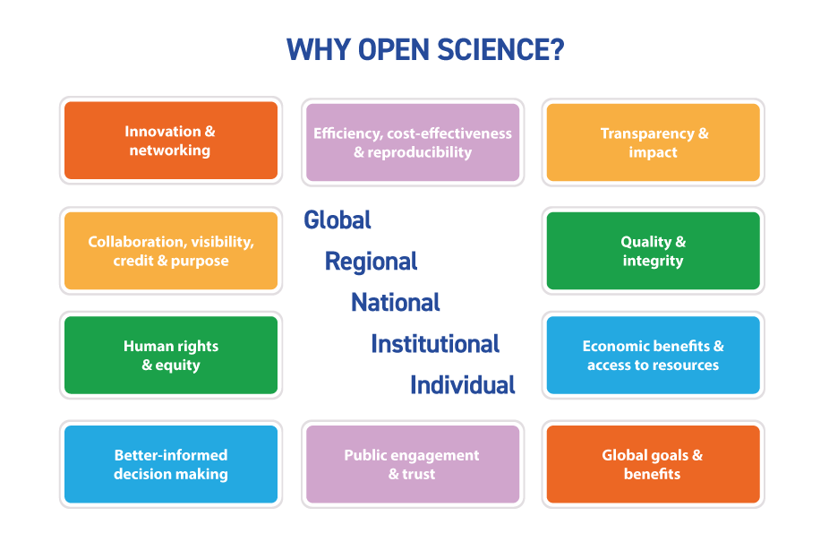

Benefits of open science

Slide 8
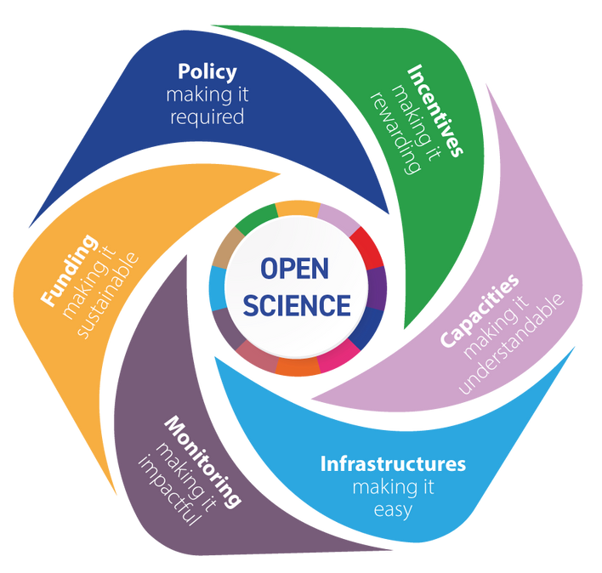
Shifting the culture of science
Need practical actions and cultural shifts
Equitable
collaboration
Actions are underway
around the world:
Cases from all regions demonstrate opportunities
Notes:
Open science challenges traditional norms and practices of ‘science’
Grounding in agreed values and principles
We will require innovation in the way concepts and practices of ‘collaboration’, ‘participation’, ‘dialogue’ and ‘partnerships’ are perceived, defined and realized by a wide range of actors and stakeholders in the science, technology and innovation (eco)systems across the globe.

Slide 9
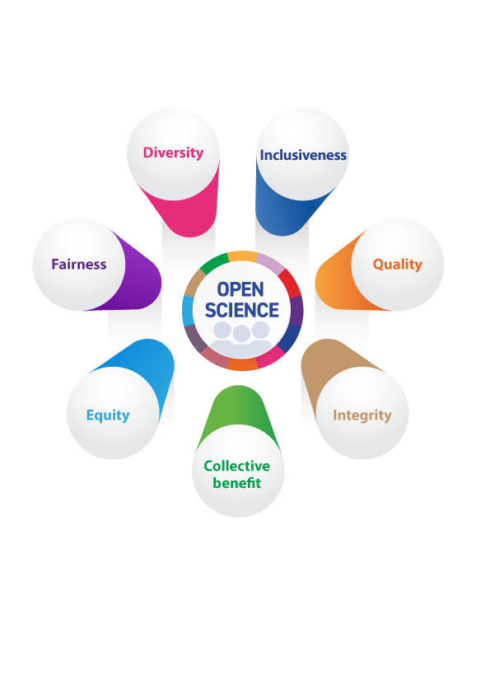
Open science values provide a
shared and flexible framework

Slide 10
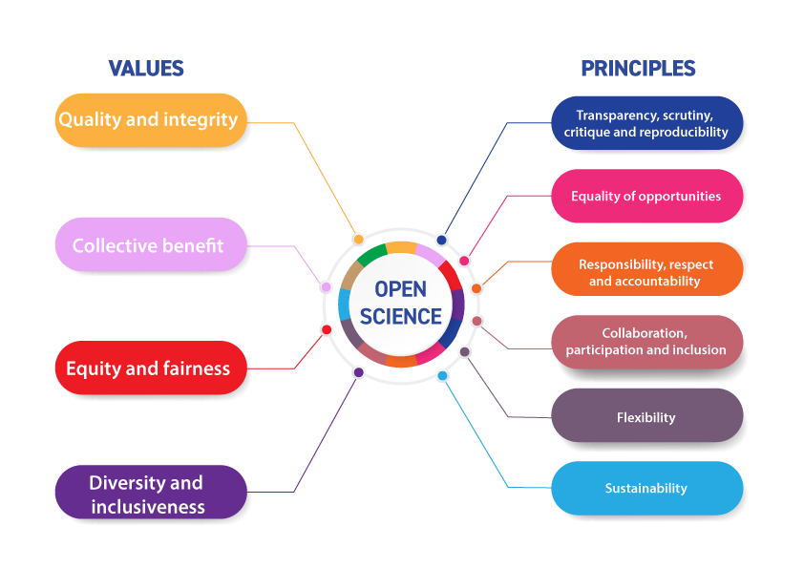

Slide 11
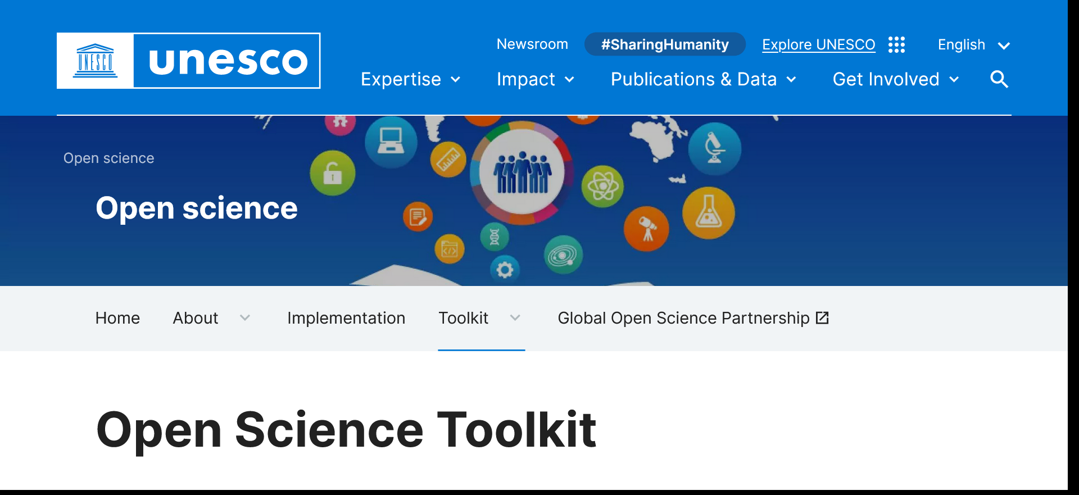
https://www.unesco.org/en/open-science/toolkit

Slide 12
Capacity building for open science
Provide systematic and continuous capacity-building for open science.
Develop individual Human Resources criteria for recognizing and rewarding open science in job descriptions, performance appraisals, and promotion criteria. These should take into account staff members’ multiple responsibilities — from research outputs to teaching to public engagement as well as considering collaborative and team accomplishments in addition to individual accomplishments when appropriate.

Slide 13

Open science infrastructures
Review the capabilities of the institutional existing organizational infrastructures — check on accessibility, interoperability, whether all settings are open science friendly
Review procurement parameters for infrastructure investments to support openness. Prioritize, as far as possible, open source software stacks for digital infrastructures for open science.
Encourage the use of PIDs, such as: ORCID for people, Digital Object Identifiers (DOIs) for outputs, ROR ids for organizations.

Slide 14
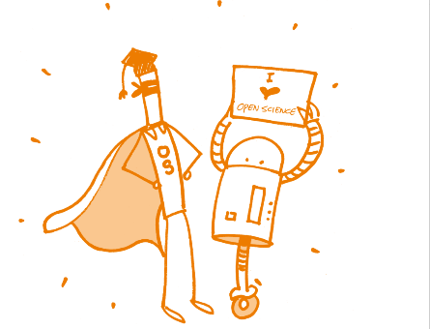
Expected outputs
Researchers, research administrators and managers, ICT staff, librarians, policy makers, citizens and community researchers understand open science principles and benefits, have knowledge and skills to practice open science and have access to on-the-job capacity development opportunities, including training on Research Data Management based on the FAIR and CARE principles.
Institutional and national focal points for open science are set up, drive the open science agenda and provide support.

Slide 15
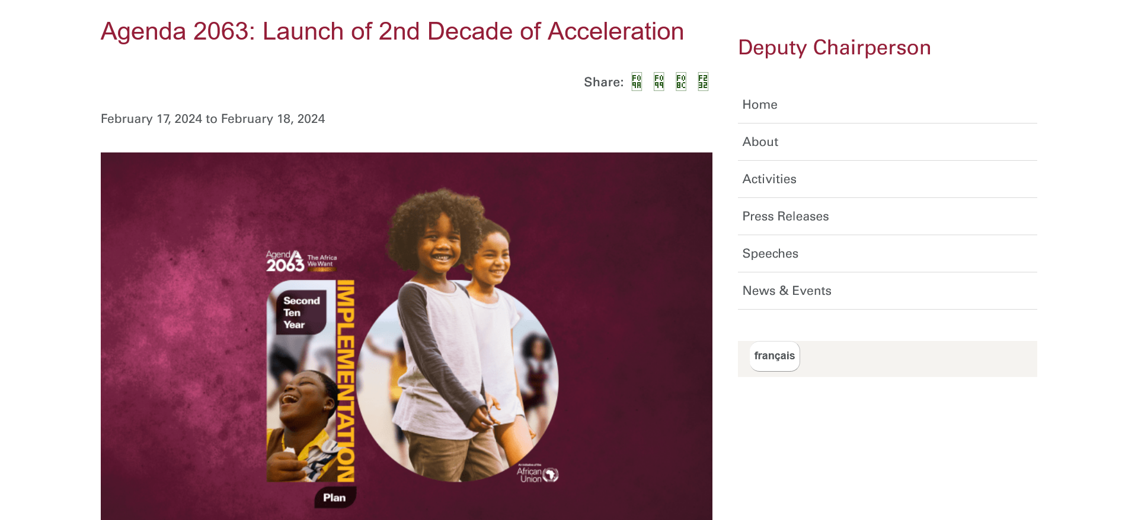
“Promote and facilitate intra-African and international research collaboration and mobility and adopt the culture of open sciences”
https://au.int/en/newsevents/20240217/agenda-2063-launch-2nd-decade-acceleration

Slide 16
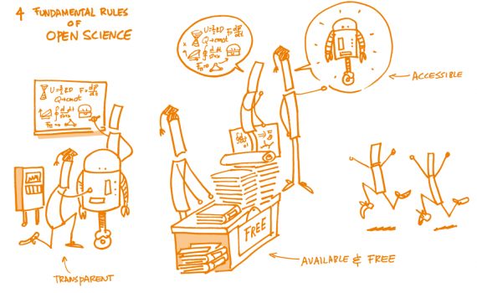
Science, Technology and Innovation Strategy for Africa 2024, African Union Commission
“A multi-disciplinary and multi-sectoral approach to Collaborative Open Innovation and Entrepreneurship and entrepreneurial innovation based on Open Data, essential to achieving the Knowledge Economy and sustainable socio-economic development across Africa”

Slide 17
Digital Transformation Strategy for Africa (2020-2030)
“open standards and interoperability for cross-border trust framework, personal data protection and privacy”
“use and creation of open educational resources”
“open data policies”
“policies and strategies that support Open Access to Scientific Knowledge”

Slide 18
AU Data Policy Framework
Promotes interoperability, data sharing, and responsiveness to data demand through the setting of open data standards in data creation conforming to the general principles of anonymity, privacy, security, and any sector-specific data considerations to facilitate non-personal data, and certain categories of personal data are accessible to African researchers, innovators and entrepreneurs.

Slide 19

AU Data Policy Framework (2)
Calls to improve unevenly developed infrastructure across the continent to support efficient broadband network coverage, reliable energy supply, and foundational digital (data) infrastructure and systems, cloud and data infrastructure, and open data sharing systems; and to govern the integrated national data system according to the principles of access, availability, openness (where anonymity can be preserved), interoperability, safety, security, quality, and integrity.

Slide 20
EIFL Strategic Plan 2024-2026
Support research, teaching and learning
Enhance open science/open research skills
Organize ‘train the trainer’ activities
Create training materials
Provide advice, knowledge and training to partner institutions and countries that are launching research data management services, ensuring as open as possible, as closed as necessary research data

Slide 21
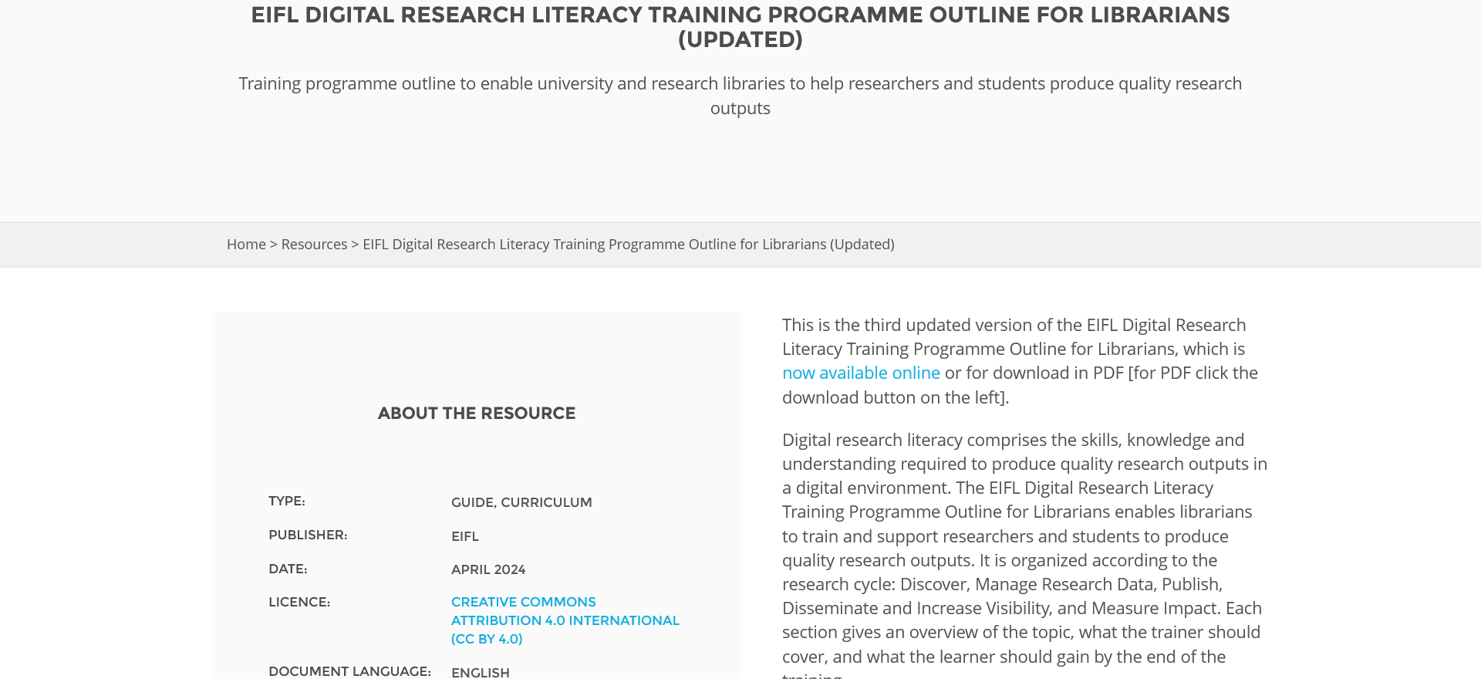
https://eifl.net/resources/eifl-digital-research-literacy-training-programme-outline-librarians-updated-2

Slide 22
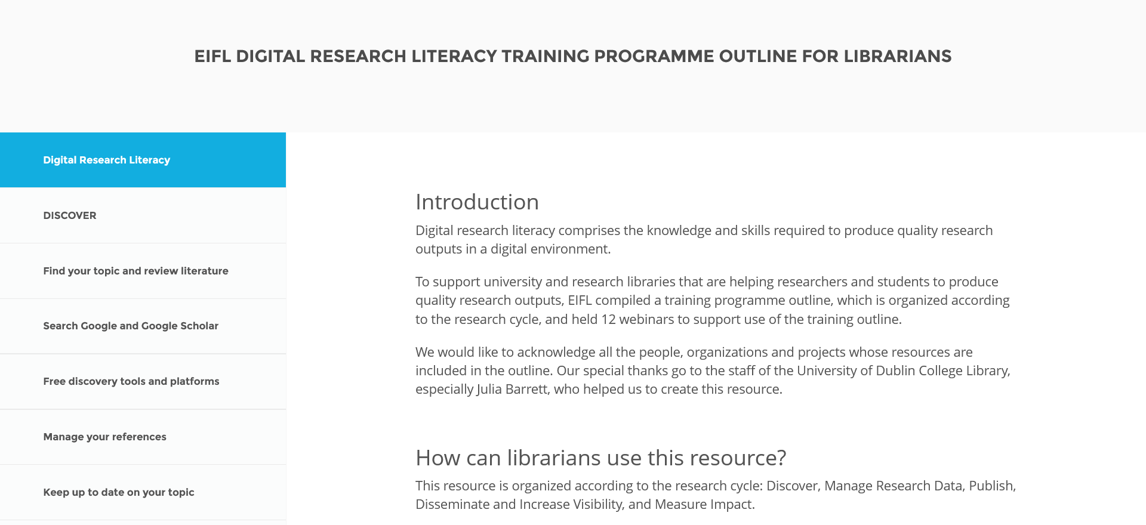
https://eifl.net/programme/digital-research-literacy/eifl-digital-research-literacy-training-programme-outline

Slide 23
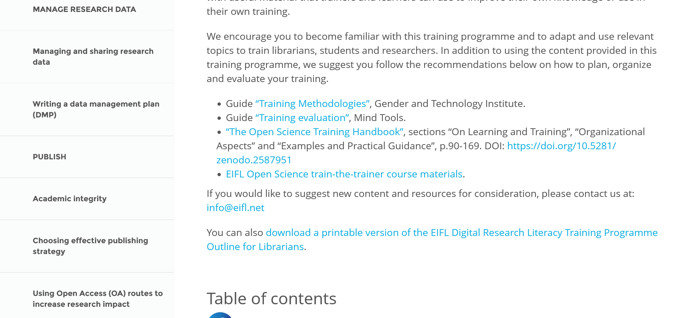
https://eifl.net/programme/digital-research-literacy/eifl-digital-research-literacy-training-programme-outline

Slide 24
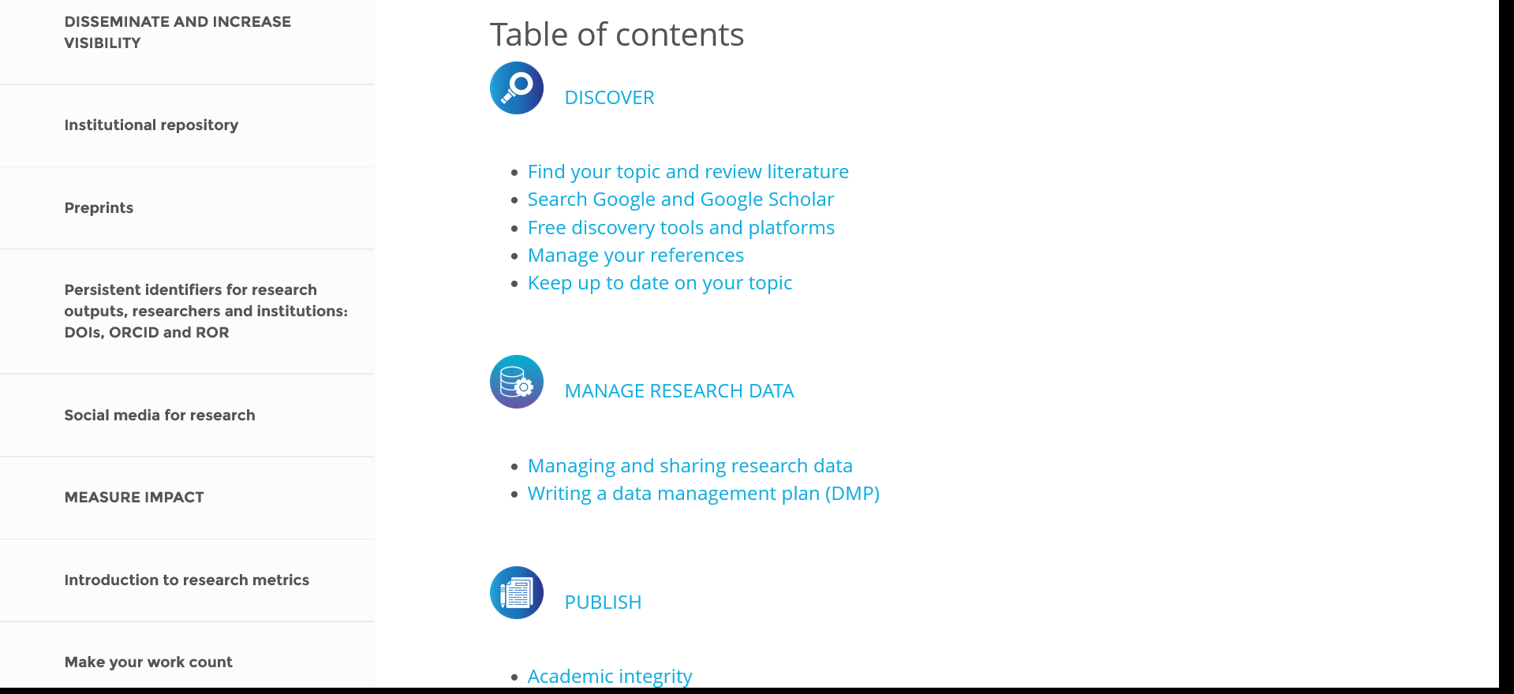
https://eifl.net/programme/digital-research-literacy/eifl-digital-research-literacy-training-programme-outline

Slide 25
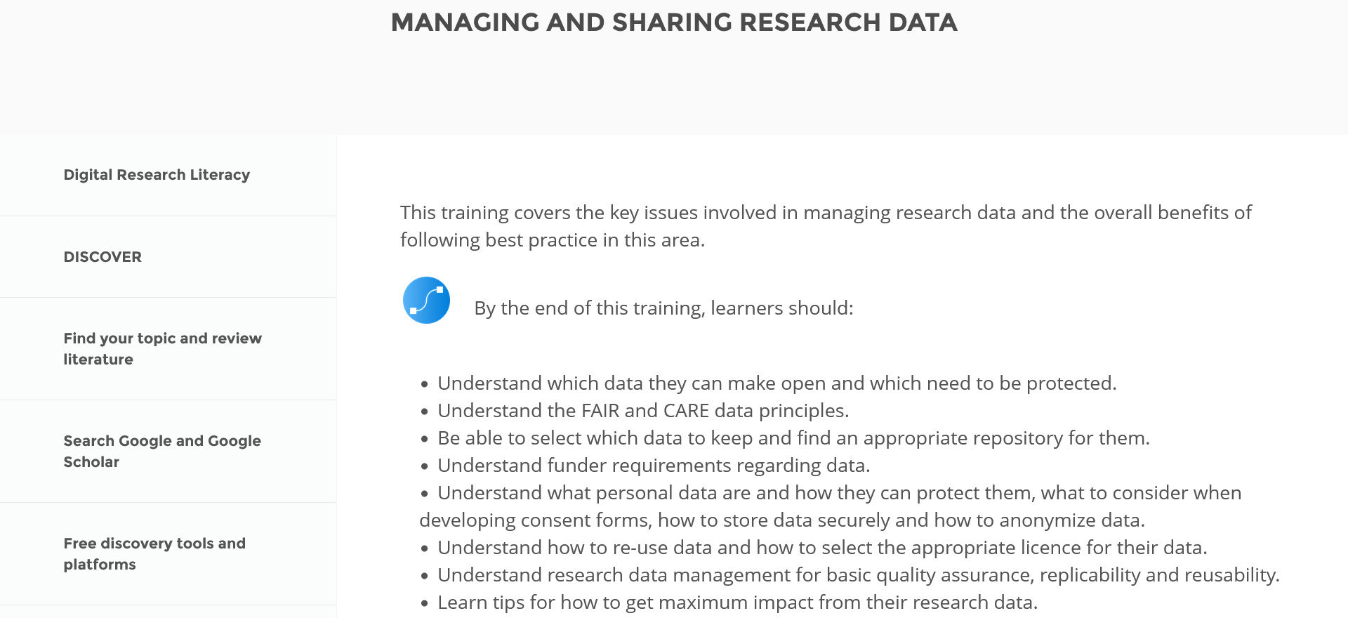
https://eifl.net/programme/digital-research-literacy/managing-and-sharing-research-data

Slide 26
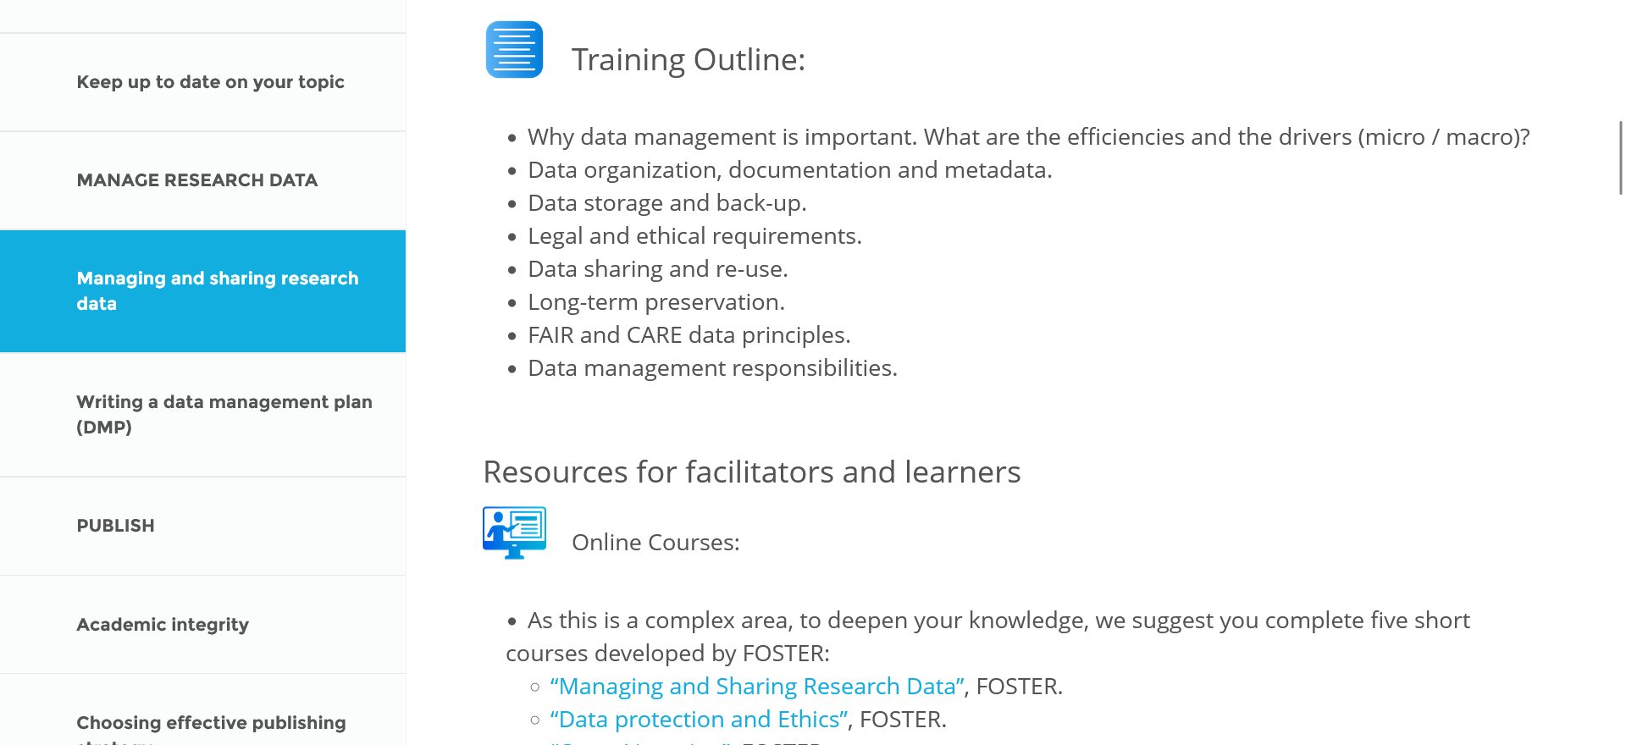

Slide 27
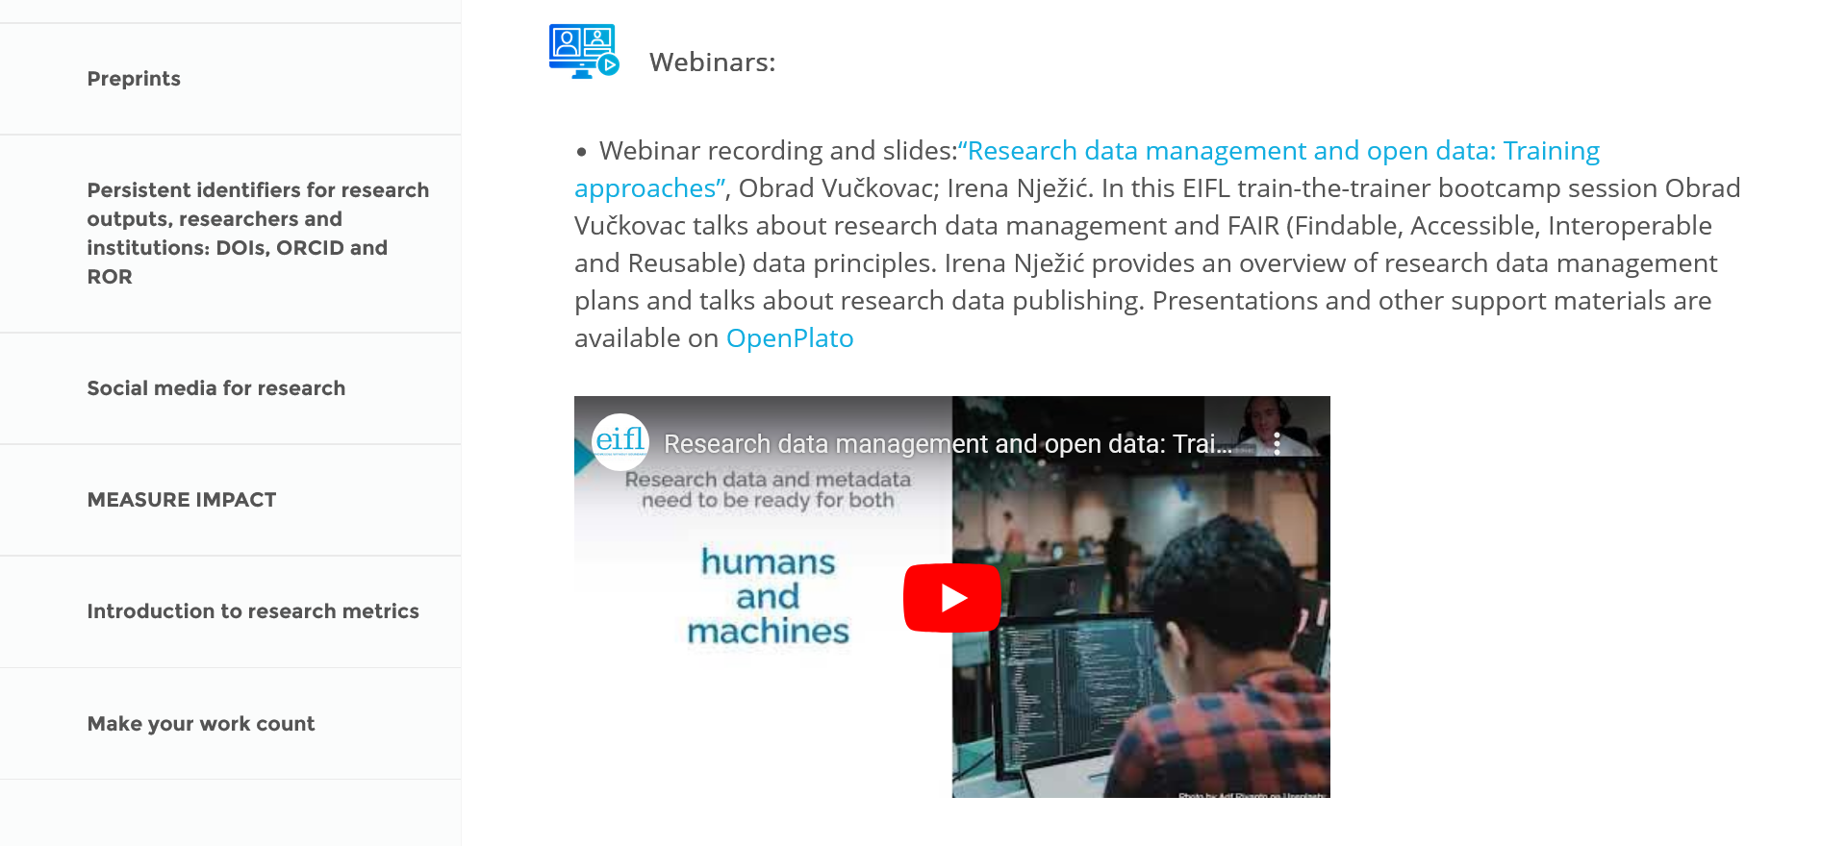

Slide 28
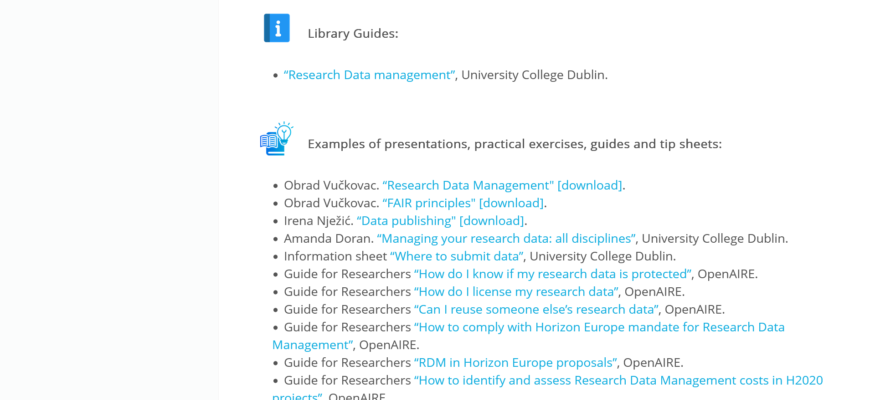

Slide 29
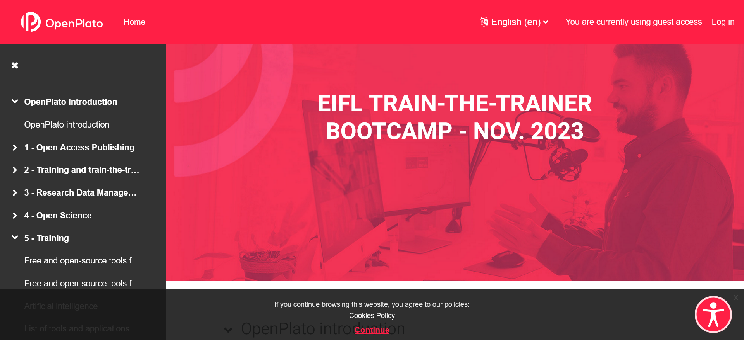
https://openplato.eu/course/view.php?id=62

Slide 30
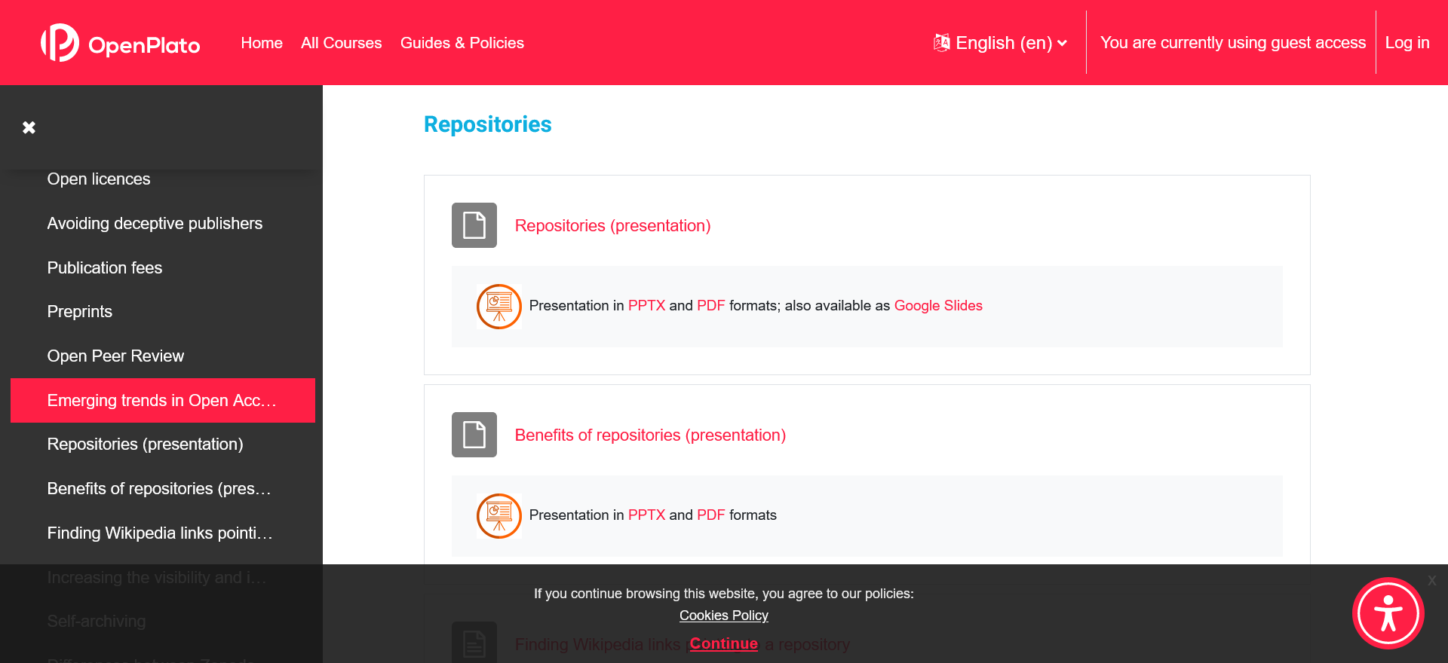
https://openplato.eu/course/view.php?id=62

Slide 31
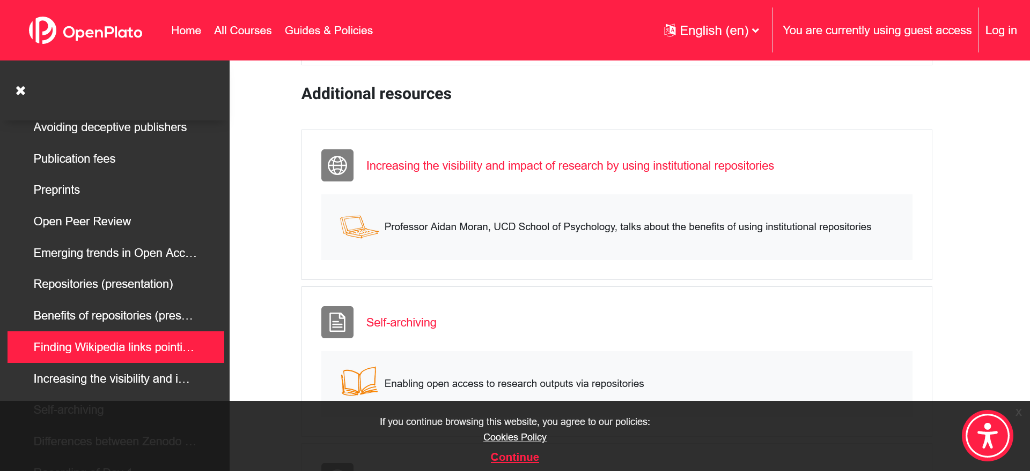
https://openplato.eu/course/view.php?id=62

Slide 32
EIFL Open Science trainers community
Contact iryna.kuchma@eifl.net if you want to join a mailing list
Shared notes from meetings: https://pad.riseup.net/p/ostraining

Slide 33
Open science for the health sciences
Link
Open Science and AI
Link

Slide 34
Zotero public collections
Disputable journals:
https://www.zotero.org/groups/5259897/disputable_journals/items/AB6CUFNP/library
Academic integrity:
https://www.zotero.org/groups/2888253/academicresearch_integrity/library
Generative AI:
https://www.zotero.org/groups/5131206/generative_ai_and_related_phenomena/library
Open science for the health sciences:
https://www.zotero.org/groups/5490937/open_science_for_the_health_sciences/library

Slide 35
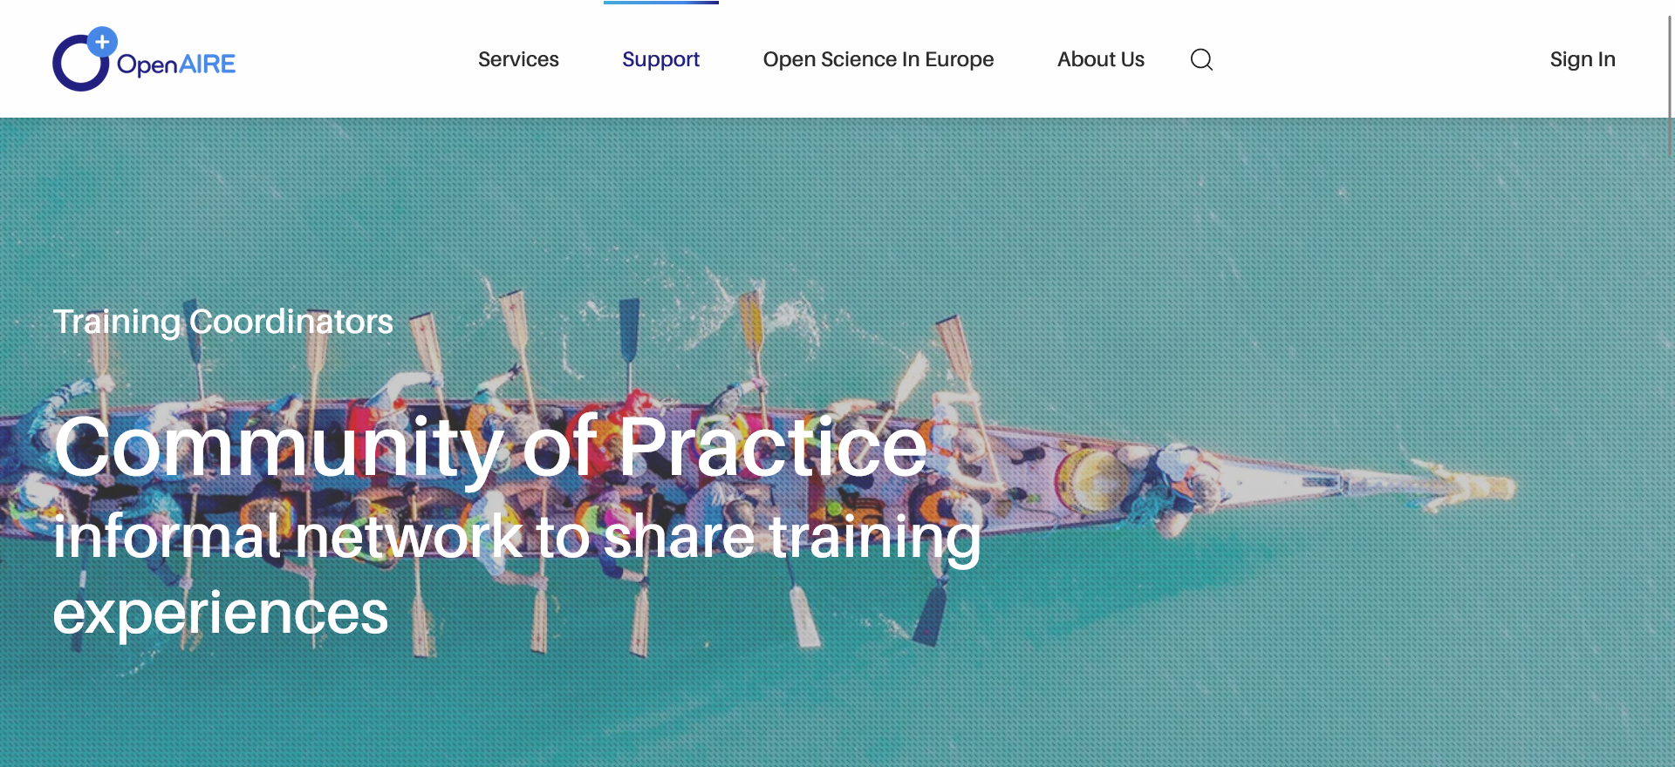
https://www.openaire.eu/cop-training

Slide 36
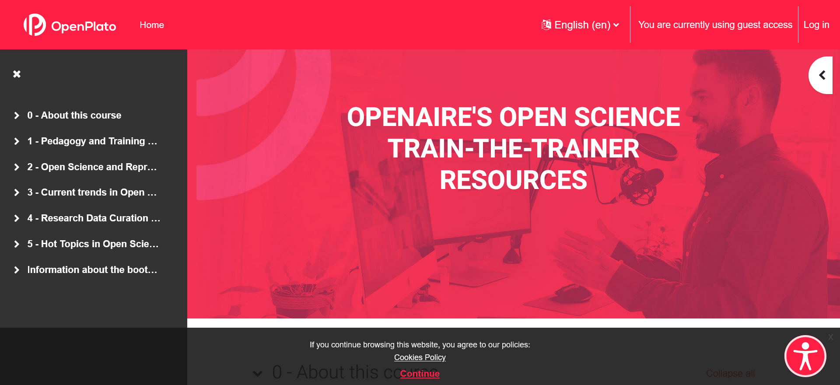
https://openplato.eu/course/view.php?id=59&lang=en

Slide 37
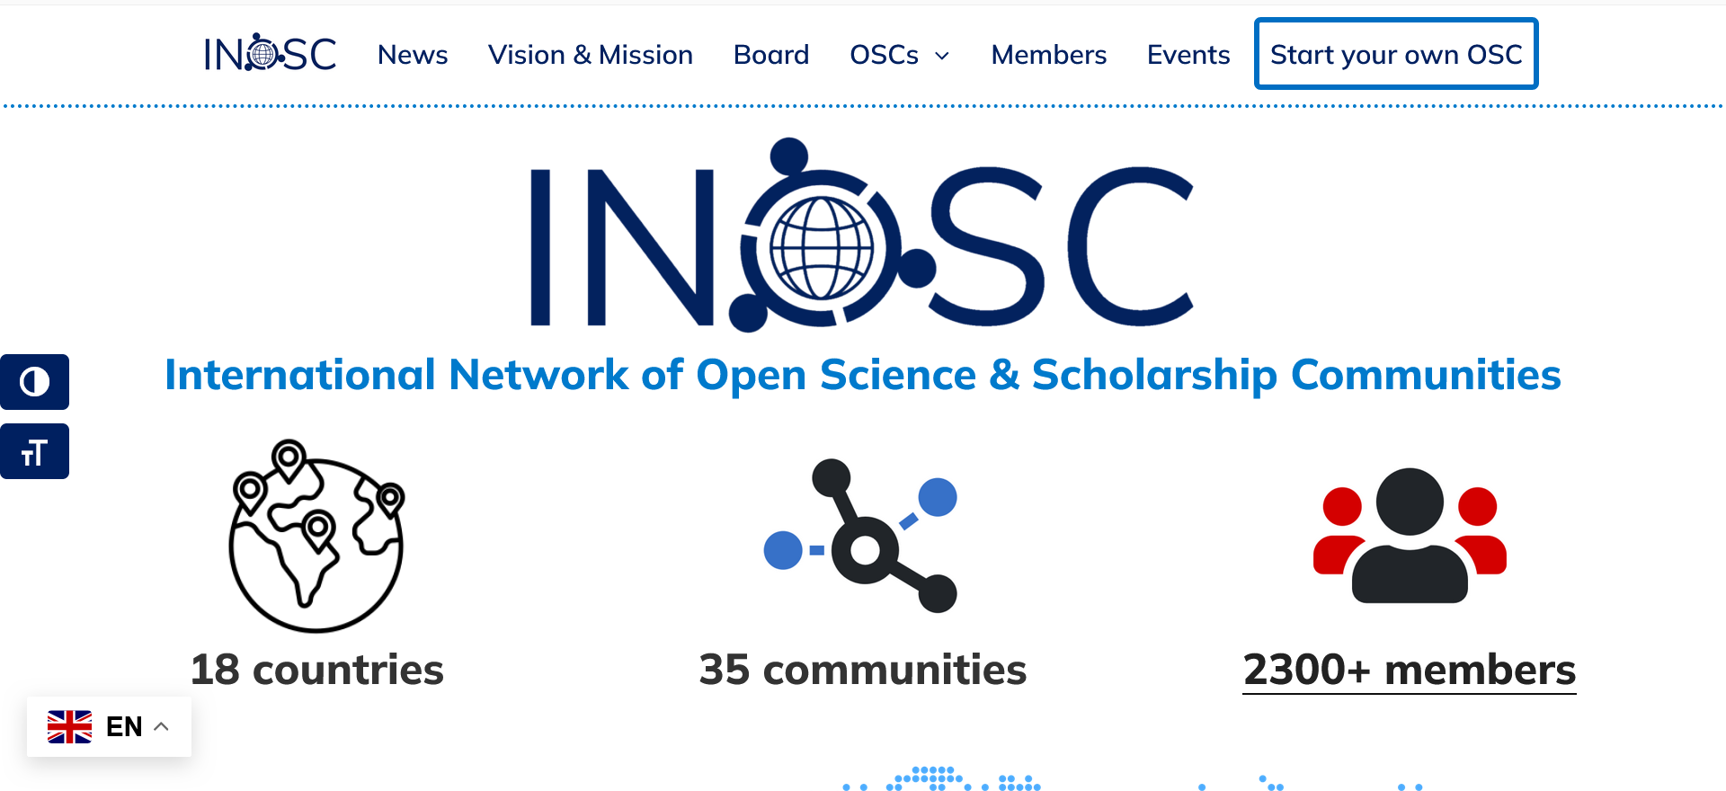
https://osc-international.com

Slide 38
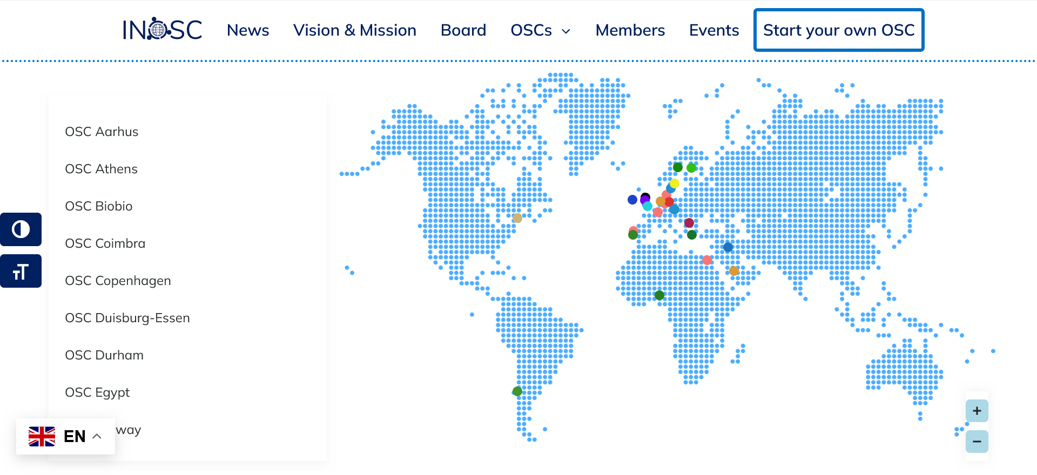
https://osc-international.com

Slide 39
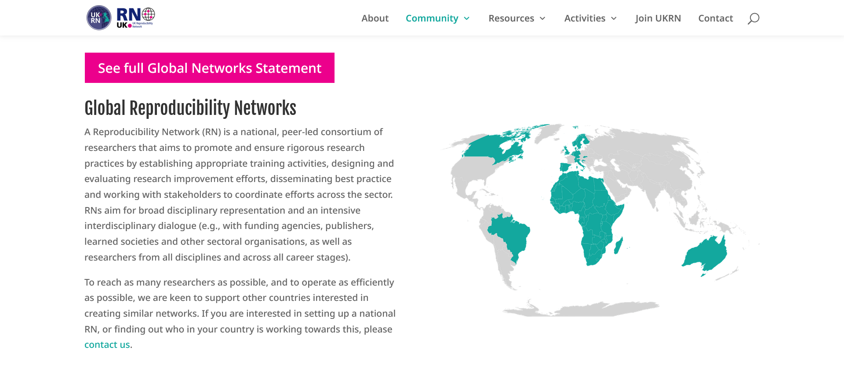
https://www.ukrn.org/global-networks

Slide 40
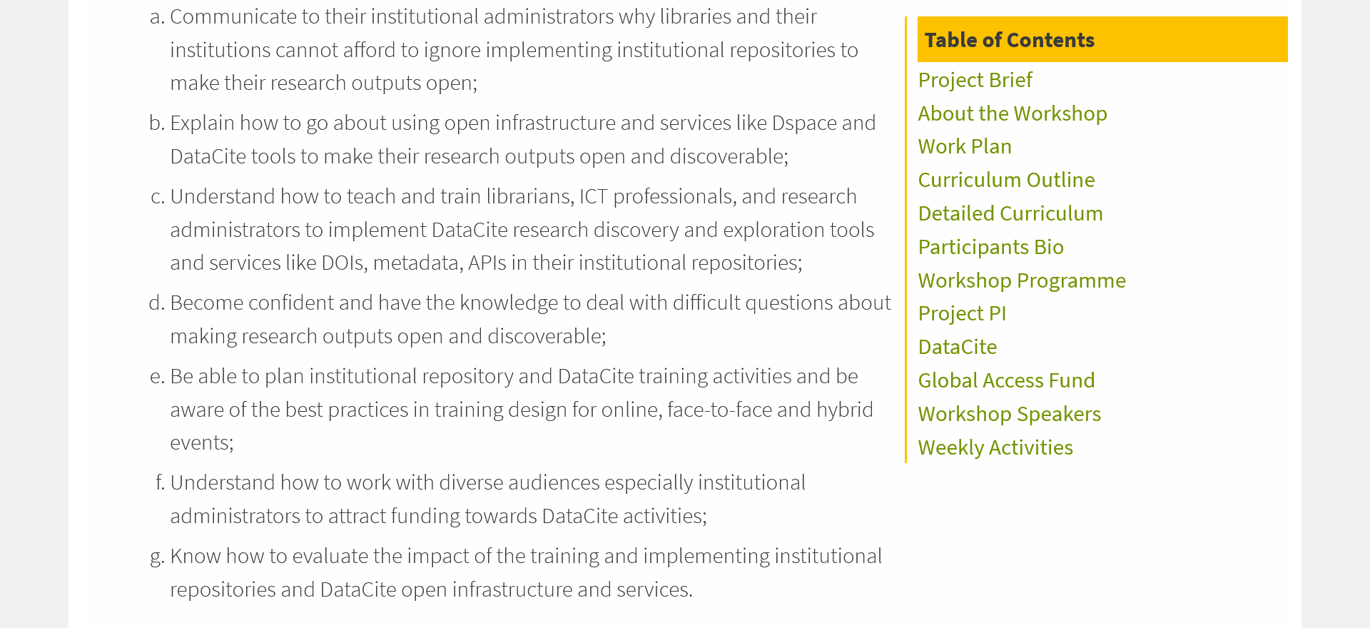
https://library.busitema.ac.ug/about/building-a-cohort-of-open-scholarship-trainers

Slide 41
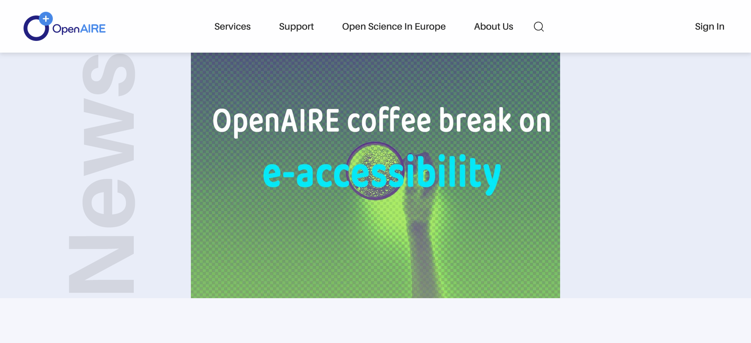
Repositories & accessible content
https://www.openaire.eu/openaire-coffee-break-on-e-accessibility-it-s-all-about-the-tools

Slide 42

Thank you!
Contact: iryna.kuchma@eifl.net
www.eifl.net

